Slide 1
Capstone Engagement
Assessment, Analysis, and Hardening of a Vulnerable System

Slide 2
Table of Contents
This document contains the following sections:
01
Network Topology
02
Red Team: Security Assessment
03
Blue Team: Log Analysis and Attack Characterization
Hardening: Proposed Alarms and Mitigation Strategies
04

Slide 3
Network Topology
‹#›

Slide 4
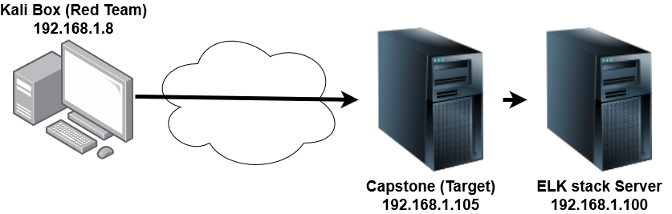
Network Topology
Network
Address Range: 192.168.1.0-255
Netmask: 255.255.255.0
Gateway: 0.0.0.0
Machines
IPv4: 192.168.1.8
OS: Linux 3.2-4.9
Hostname: root
IPv4: 192.168.1.105
OS: Linux 3.2-4.9
Hostname: root
IPv4: 192.168.1.100
OS: Linux 3.2-4.9
Hostname: root

Slide 5

Red Team
Security Assessment
‹#›

Slide 6
Recon: Describing the Target
Nmap identified the following hosts on the network:
Hostname | IP Address | Role on Network
Windows machine | 192.168.1.1 | General purpose
ELK | 192.168.1.100 | ELK server (security monitoring)
Capstone | 192.168.1.105 | General purpose -- Apache server
Kali | 192.168.1.8 | Security -- Penetration testing

Slide 7
Vulnerability Assessment
The assessment uncovered the following critical vulnerabilities in the target:
Vulnerability | Description | Impact
Port/service scanning | Enabled scanning of ports and active services. | Allows attackers to view potentially vulnerable services and vectors for exploitation.
Weak credentials | Credentials that are easily guessable or can be obtained through automation. | Allows for attackers to more quickly find login information to obtain info or perform other tasks.
Unlimited login attempts | No action taken by the SIEM to limit the number of failed logins. | Allows for brute force attacking by leaving user accounts open to multiple attempted logins.
Published administrative information to the public server | Information to log into the ‘webdav’ system folder along with user password has | Allows for direct access to modify server and/or obtain highly sensitive company information.

Slide 8
Exploitation: Port scanning
01
02
03
Tools & Processes
Simple pinging and NMAP scanning allowed for the discovery of vulnerable services, specifically the older version of Apache web server and website structure.
Achievements
With this information, I was able to more easily traverse the website structure and find the vulnerable Apache software, leading me to place the reverse shell on the site.
See next slide for screenshot.

Slide 9
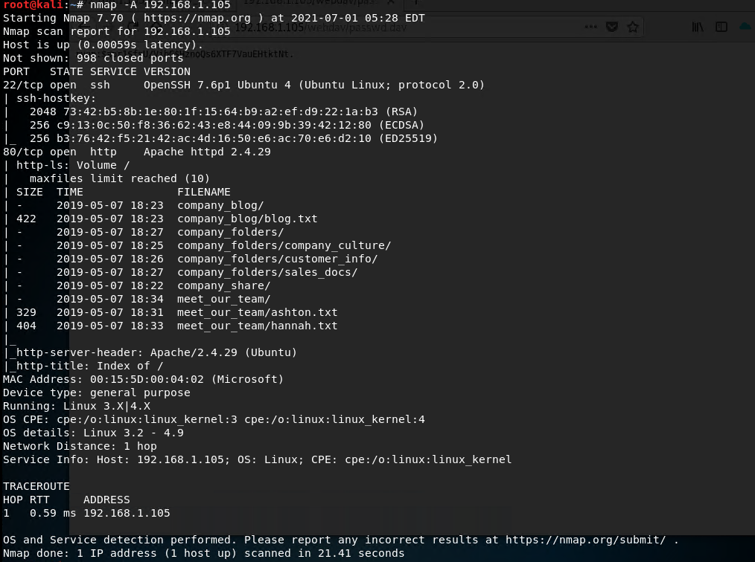
Exploitation: Port scanning

Slide 10
Exploitation: Weak credentials
01
02
03
Tools & Processes
Using Hydra tool, I was able to brute force multiple login attempts with a simple wordlist for the ‘ashton’ user account.
Achievements
Upon finding the successful password combination, I was able to get into the company “secret folder” containing important credential information for administrative access to the server (see also Exploitation 4).
See next slide for screenshot.

Slide 11
Exploitation: Weak credentials

Slide 12
Exploitation: Unlimited login attempts
01
02
03
Tools & Processes
Again, with the Hydra tool, the brute force attack was able to occur with over 10,000 login attempts without any impedance.
Achievements
Able to access the the ‘ashton’ account which has access to the company “secret folder”. However, theoretically I would be able to log into almost any account if the passwords were weak enough and/or I utilized a more complex wordlist.
See next slide for screenshot.

Slide 13
Exploitation: Unlimited login attempts
Note the number of login attempts before the password was found for the ashton account.

Slide 14
Exploitation: Published administrative information to the public server
01
02
03
Tools & Processes
Using crackstation, I was able to decrypt the hashed password of user account ‘ryan’ and gain access to the WebDAV folders for the server. Afterwards, MSFVenom and MSFConsole were used to establish a reverse shell on the server.
Achievements
Upon logging into the WebDAV system, I was able to find a password to SSH into the server itself while also uploading a reverse shell script to the server.
See following slides for screenshots of process.

Slide 15
Exploitation: Published administrative information to the public server

Slide 16
Exploitation: Published administrative information to the public server

Slide 17

Blue Team
Log Analysis and Attack Characterization
‹#›

Slide 18
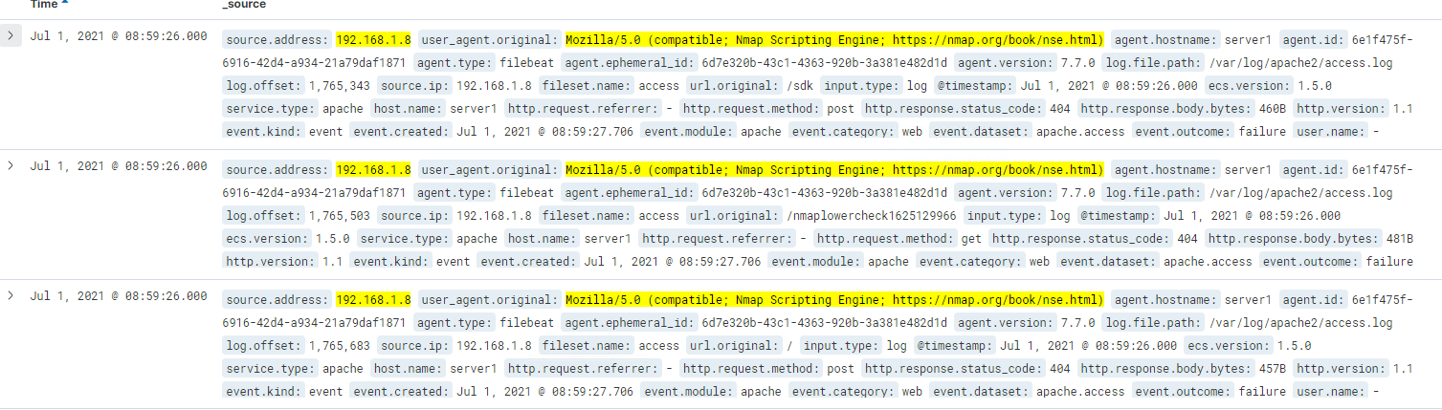
Analysis: Identifying the Port Scan
The port scan began at 08:59 AM and ended at 09:03 on 7/1
Approximately 33 packets were submitted from 192.168.1.8 (the IP of the Red Team system)
Early user agents were listed as an NMAP Scripting Engine, which is a port scanning tool

Slide 19
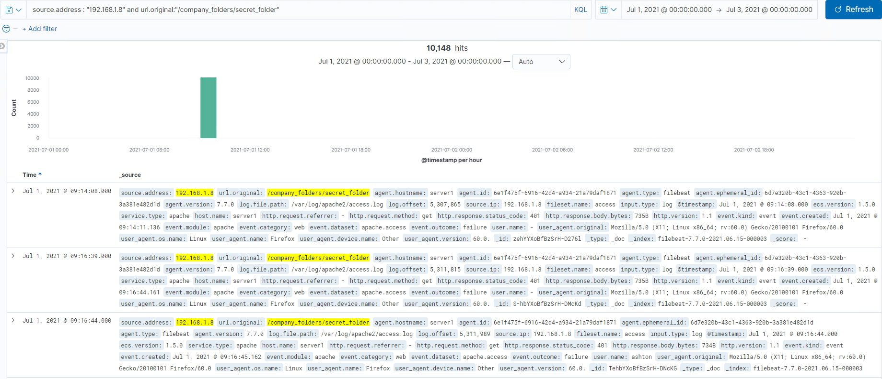
Analysis: Finding the Request for the Hidden Directory
The request occurred at 09:14 with only one initial request made (more were done during the brute force attack)
The only request was for access to the /company_folders/secret_folder directory. Because this leads to the login page for the server, this makes sense.

Slide 20
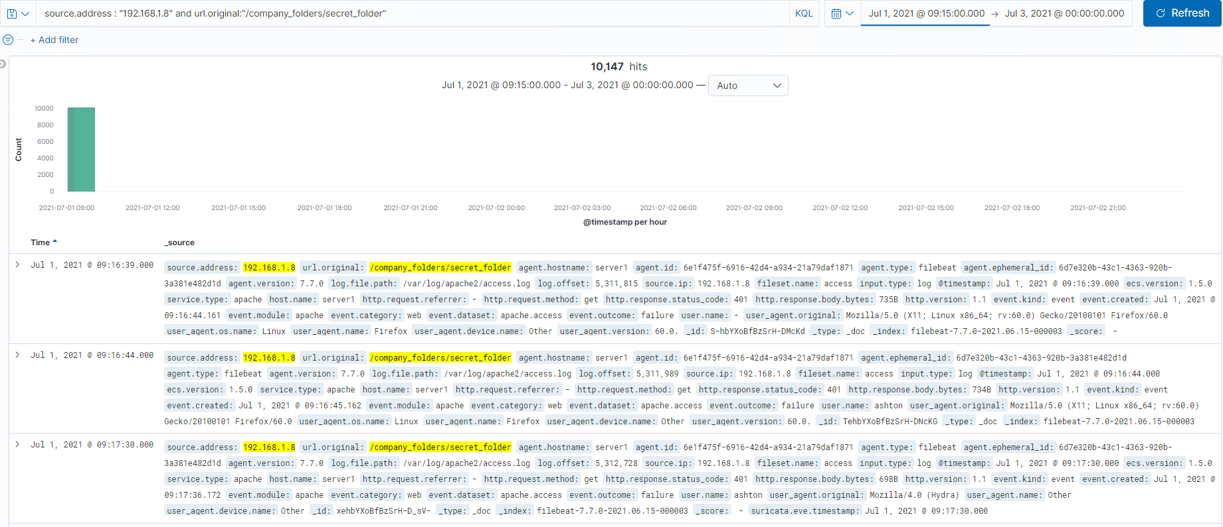
Analysis: Uncovering the Brute Force Attack
10,147 requests were made during the attack
10,145 requests had failed based on the number of error responses (error code >=400)

Slide 21
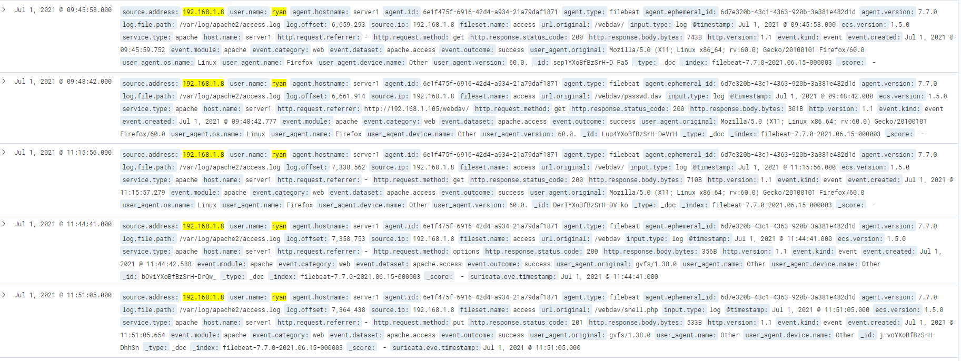

Analysis: Finding the WebDAV Connection
[Insert Here]
Add a screenshot of Kibana logs depicting the WebDAV connection.
21 requests were made to the /webdav directory
There was a request for the directory page itself, access to a file named “passwd.dav” and a put request for a “shell.php”

Slide 22
Blue Team
Proposed Alarms and Mitigation Strategies
‹#›

Slide 23
Mitigation: Blocking the Port Scan
Different types of alarms can be used to detect port scans.
Filters for scanning tools (like NMAP)
This threshold can be set to 1 for instant detection
Filters for uncommon ports
Depending on the usage of these uncommon ports, threshold can be very low (1-5) or moderate (~10)
Filters for requests of multiple ports from the same IP in a certain timeframe
This threshold can be set to 10+ depending on the typical traffic the server receives
Firewalls can reduce visibility of open ports outside the network and can also be set up to detects and shut down port scans in progress
Closing unnecessary ports on the router can prevent them from being accessed by scanners
If the budget allows, set up a front facing server for the website and an internal server for the network that cannot be accessed from outside

Slide 24
Mitigation: Finding the Request for the Hidden Directory
Access of the directory from an external IP (i.e. an address outside the company’s IP range)
Threshold for this alert can be set to 1
Attempted access by non-authorized users within the network can also be utilized for an alarm system
In case of unintended access, the threshold can be a little higher (~5)
Depending on the frequency of access for authorized users, an alarm can also be triggered, but this will require monitoring of these authorized users for normal access times
Unwanted access can be easily mitigated by creating a network rule denying directory access from external IPs
For authorized users within the network, redundancy systems like two-factor authentication can protect the directory from compromised accounts
Placing this directory in a totally private, internal network can also prevent outside access

Slide 25
Mitigation: Preventing Brute Force Attacks
Brute force attacks can be easily monitored with an alert created based on failed login attempts beyond typical human error
A good threshold for this error can be around 5-10 failed attempts
As with many other parts of this situation, creating alerts based on external IP access would also be wise
Alerts can be set to as low as 1, but as high as 10 depending on allowed external access to the network
Attacks like this can be mitigated by locking user accounts after a certain threshold of failed login attempts (like the alarm, 5-10 failed attempts is reasonable for human error)
Mandating harder password policies will also help as increased complexity will greatly reduce the ability for systems to guess the passwords
Two-factor authentication may also be helpful in the event of successful attack within the threshold

Slide 26
Mitigation: Detecting the WebDAV Connection
Attempted access to this directory via non-authorized accounts could trigger an alarm
Threshold of 1 can be allowed for this as it is a high risk directory
Access to the directory via external IP is also a good trigger to consider with a low threshold
Depending on future usage of the directory, write access (put requests in this case) should also be for consideration for alarm, especially via external addresses
Depending on the developers’ needs, the WebDAV directory could be placed in a private server with an unreadable and un-editable copy placed on the public server
Changing the access to the directory to disallow both unauthorized users and external IP addresses would also prevent unwanted connection
If possible, it may also be ideal to change software to a more stable/secure architecture

Slide 27
Mitigation: Identifying Reverse Shell Uploads
An alarm can be set up to detect put requests beyond normal capacity for internal IPs
The threshold will vary based on the frequency of uploading to the server and certain directories
An alarm should be set up for put requests for external IPs
This threshold can be set to 1 since it will likely be unauthorized access to the server in this instance
Alarms can also be set to detect outbound internet traffic to certain IPs, but this threshold is dependent on typical business practices
Blocking all access of certain folders to external IP addresses would mitigate this threat by outside agents
If all external access cannot be blocked, then changing http settings to deny put requests can suffice
Reducing or limiting outbound internet traffic can also be helpful as it can prevent systems from communicating unintentionally with threat agents

